Slide 1



Introduction Azure Cosmos Database
John Miner Data Architect
john.miner@bluemetal.com
Blog: www.craftydba.com www.mssqltips.com
Tweet: JohnMiner3

Slide 2
Target Audience
Developers
Solid understanding of what a document store gives you. How to create, read, update and delete JSON documents.
Azure Administrators
How to manage the various components that make up a Cosmos Database.

Slide 3
How NoSQL came about
Some technical problems lend themselves to storing and retrieving data from a relational database management system (RDBMS). Edgar Codd came up with the idea of a relational model when he was working at IBM’s San Jose Research Library in 1970. The purpose of this model was to abstract the relational database so that it was not bound to any particular application.
Other technical problems do not lend themselves to storing and retrieving data from a predefined table. The popularity of NoSQL databases started with companies such as Facebook, Google and Amazon when working with big data problems and/or real time web applications. This set of technology is coined “Not Only SQL” since they might support a SQL syntax for retrieving data.

Slide 4
Various NoSQL Offerings
A key value store uses the concept of an associative array to save and retrieve data. The Webster dictionary is the physical implementation of this concept.
A document store encapsulates all the data for an entity (document) using a popular encoding format such as XML or JSON. This technology is popular with applications that have a variety documents with different attributes.
A graph store contains a bunch of elements with a finite number of connections between them. Data such as social relationships, road maps and/or network topologies can be easily represented with this technology.
A column store saves the data using columns instead of rows. This means that columns with discrete values can be highly compressed.

Slide 5
Presentation Overview
S&P 500 data as JSON documents.
Document attributes.
Review document store architecture.
Log into Azure Portal.
Create database account.
Define database & collection.
Loading and manipulating data
Explore documents, queries and scripts.
Reporting with Power BI

Slide 6
Big Data = Stock Data?
When dealing with big data, most computer scientist talk about Volume, Velocity and Variety.
If we are talking about real time trading, the volume tickets to buy or sell at NASDAQ can be high.
The velocity is at the second or less time frame. This means many records over the period of 7 hours.
However, the variety is static. All trading data conforms to a particular format.

Slide 7
S&P 500 Stock Data
The S&P 500 stock data from yahoo financials is a subset of a big data problem.
We have roughly 500 companies defined on Wikipedia as being part of the prestigious group.
Each day, we have one record that states the open, low, high and close stock values. Also, the total traded volume is recorded.
Example 1 – Show stock data

Slide 8
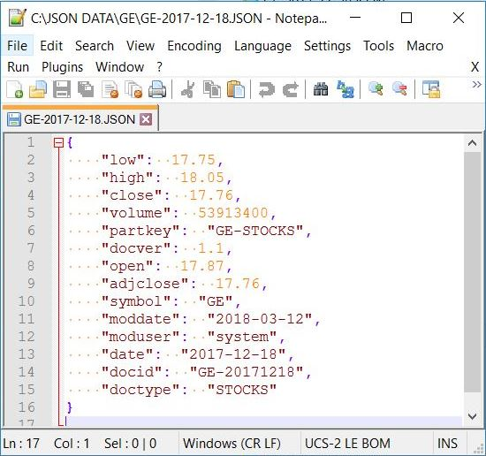
Document Attributes
Consider adding the following attributes to your documents.
Type – Allows filtering by document type.
Version – Versions might have different properties.
Mod User – Who added or updated the record?
Mod Date – When was the record last touched?
Part Key – How to partition the data?

Slide 9
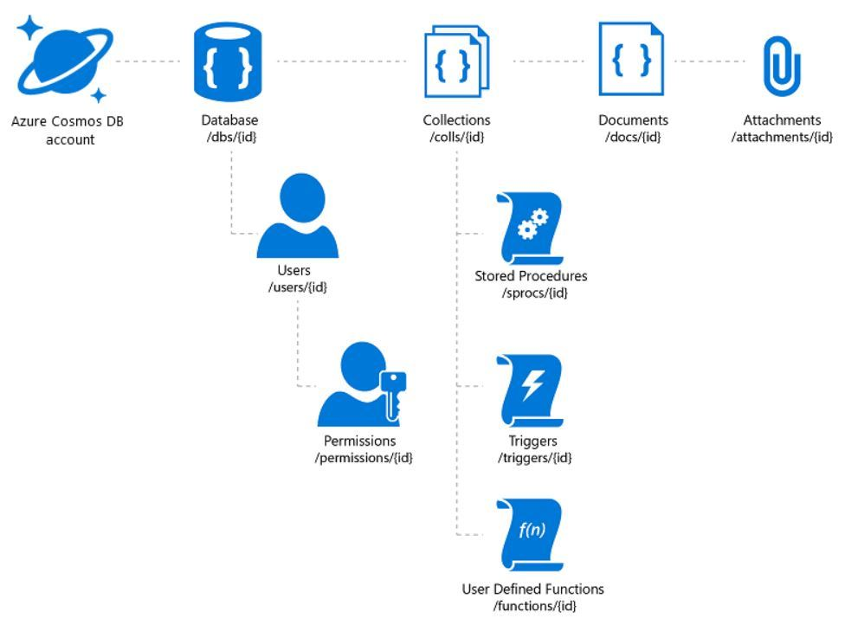
Cosmos DB – SQL API - Architecture
The Cosmos DB account determines which API to use.
Users and permission can be assigned at the database level.
Each database can have one or more collections.
Each collection is governed by resource units (RU)
User defined JavaScript can be created for functions, triggers and stored procedures.
Documents at the bottom of the tree.

Slide 10
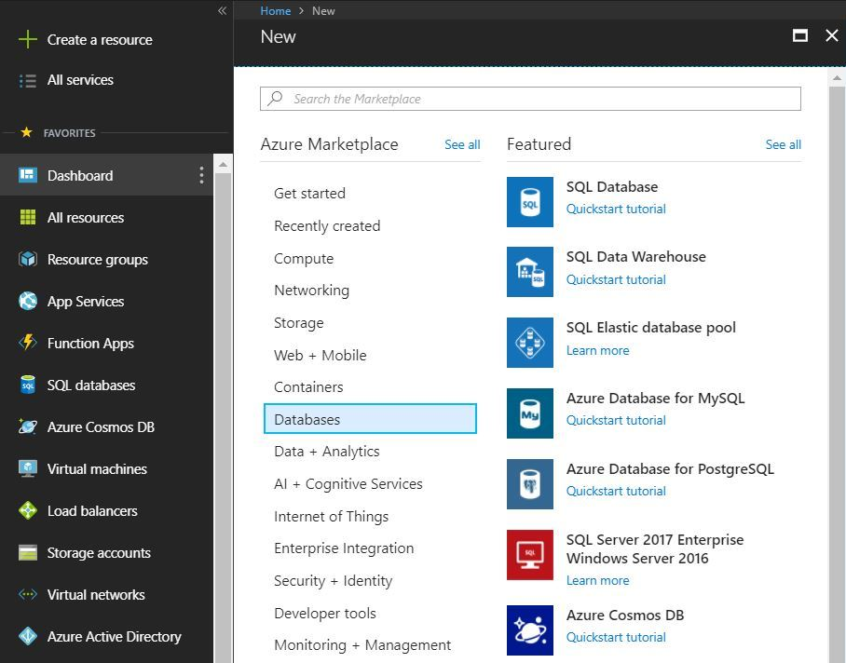
Azure Portal – Create new account
Enter database account id
Choose API – 5 different choices
SQL API – Document DB
Create resource group
Select location
Example 2 – Create new account

Slide 11
Azure Portal – Create new collection
Create new or use existing database
Choose a collection name
By default, storage is maxed at 10 GB and 10K resource units
Select partition scheme for unlimited storage and 100K resource units
Choose partition key
Choose unique key
Cosmos DB automatically indexes the data
Example 3 – Create a new collection

Slide 12
Loading Data
Azure portal used to import up to 100 JSON documents at a time.
Cosmos Data Migration tool can import unlimited documents.
Azure Storage Explorer can add on record at a time.
Example 4 – Load & show data

Slide 13
Programming
Supports subset of ANSI SQL language can be used to return data.
JavaScript can be used to extend the database.
Triggers can perform actions on inserts, updates and deletes.
Functions can be used in queries.
Stored procedures can be used to package up business logic.
Example 5 – Selecting data

Slide 14
Reporting
Power BI has a connector for Cosmos database. Grab the information about the URL and primary key from the Portal. Supply this information as well as the database and collection names when configuring a connection.
Edit the properties of the query to exclude any fields you do not want. Normal aggregations such as min, max, avg, and etc. can be applied when designing a visual.
Just remember, data is pulled from Cosmos DB and stored in the internal column store of the Power BI product.
Example 6 – Reporting off data

Slide 15
Summary
Some technical problems lend themselves to storing and retrieving data from a relational database management system (RDBMS).
Other technical problems do not lend themselves to storing and retrieving data from a predefined table.
Today we talk about the four typical “Not Only SQL” offerings: key-value store, document store, graph store and column store.
Consider using Cosmos DB document storage if your business problem fits the use case.

Slide 16
References
Cosmos DB – Documentation
https://docs.microsoft.com/en-us/azure/cosmos-db/
Cosmos DB – SQL queries
https://docs.microsoft.com/en-us/azure/cosmos-db/sql-api-sql-query
Azure Storage Explorer
https://azure.microsoft.com/en-us/features/storage-explorer/
Cosmos DB – Migration Tool
https://docs.microsoft.com/en-us/azure/cosmos-db/import-data
Power BI - Connector
https://docs.microsoft.com/en-us/azure/cosmos-db/powerbi-visualize
|

Slide 17
Biography
John Miner is a Data Architect at Blue Metal helping corporations solve their business needs with various data platform solutions. He has over twenty five years of data processing experience, and his architecture expertise encompasses all phases of the software project life cycle, including design, development, implementation, and maintenance of systems. His credentials include undergraduate and graduate degrees in Computer Science from the University of Rhode Island. He has also earned certificates from Microsoft for Database Administration (MCDBA), System Administration (MCSA) and Data Management & Analytics (MCSE). Before joining Blue Metal, John won the Data Platform MVP award in 2014 and 2015 for his outstanding contributions to the SQL Server community. When he is not busy talking to local user groups or writing blog entries on new technology, he spends time with his wife and daughter enjoying outdoor activities. Some of John’s hobbies include wood working projects, crafting a good beer and playing a game of chess.
|

Slide 18
Thank You
We look forward to working with you to manage business today and transform the future

